Slide 1
BALL –CHASER ROBOT
ROS (SAJITH SIR)

Slide 2
Our Team
Chandu Janaki Ram
Penaka Vishnu Reddy
S.V.S Dhanush
CB.EN.U4AIE20009
CB.EN.U4AIE20048
CB.EN.U4AIE20068

Slide 3
Introduction
Using the Robotics Operating system (ROS) capability and gazebo platform to construct a basic ball tracking vehicle.To hunt down the ball, this bot employed a camera to capture frames and do image processing using open cv.The ball's characteristics, such as color, shape, and size, can be employed.Our goal was to create a rudimentary prototype for a bot that can detect and follow color.

Slide 4
OBJECTIVE
Implementing a automated wheeled robot for tracking ball in ROS and gazebo

Slide 5
The main aspect of our problem statement is to build an autonomous wheeled robot in ROS and gazebo environment for tracking down the white ball
Problem Statement

Slide 6
What is Ball-Chaser Robot

Slide 7
Initially the camera fixed on top of the robot captures the image. It searches for a circular shape containing white pixels in the image captured. If the white pixel is detected, the robot assumes it to be the ball and it starts following it . But if the pixels are not detected, it captures the image until it detects a white pixel.

Slide 8
Packages
Firstly , we create 3 packages (world, robot description, script packets)
my_robot package defines the mobile robot as well the world that it is housed within.
ball_chaser package contains two nodes which are responsible for locating the ball

Slide 9
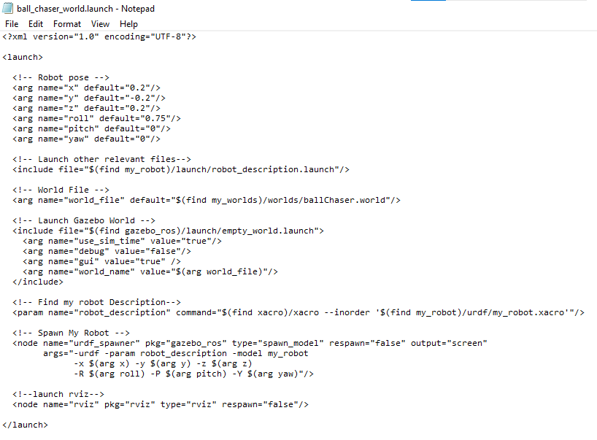
ball_chaser_world.launch
From world launch file we will launch the robot also. roslaunch my_robot ball_chaser_world.launch

Slide 10
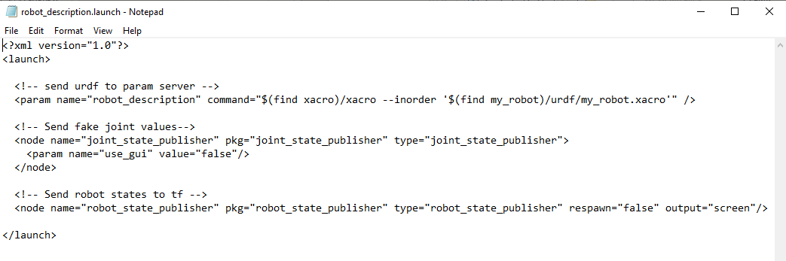
robot_description.launch

Slide 11
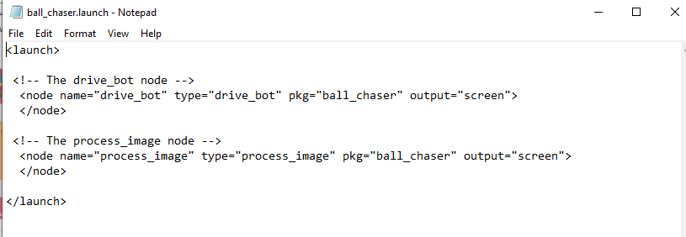
ball_chaser.launch

Slide 12
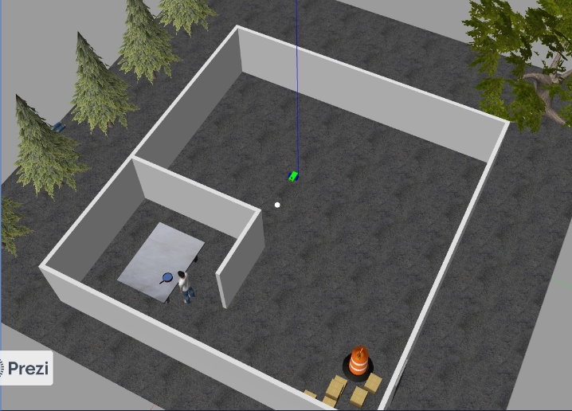
Our World

Slide 13
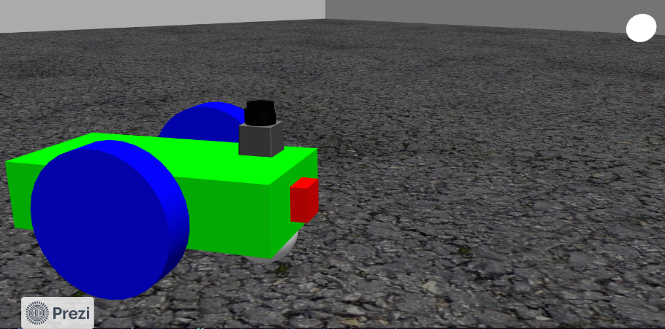
Our robot

Slide 14
Code
srv
process_image.cpp
drive_bot.cpp

Slide 15
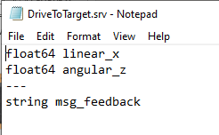
srv

Slide 16
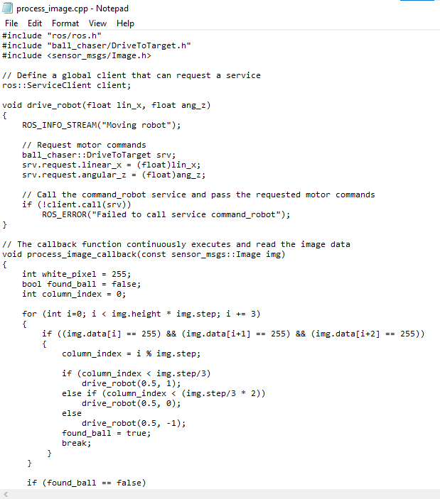
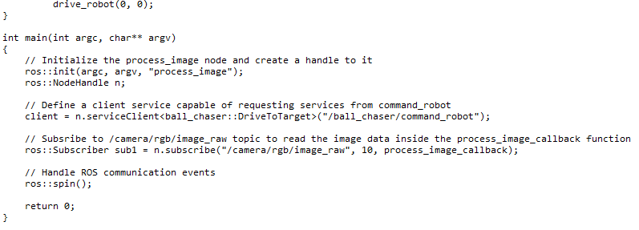
process_image.cpp

Slide 17
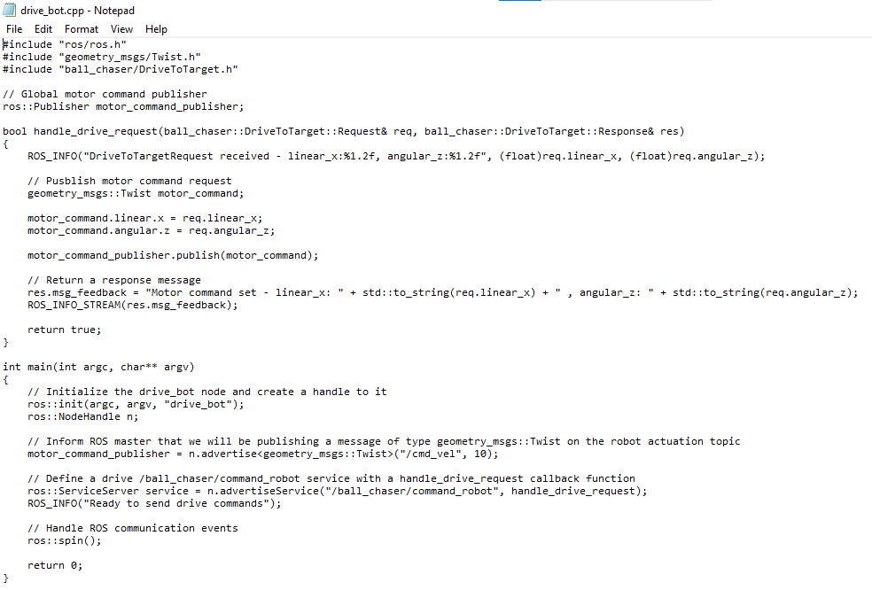
drive_bot.cpp

Slide 18
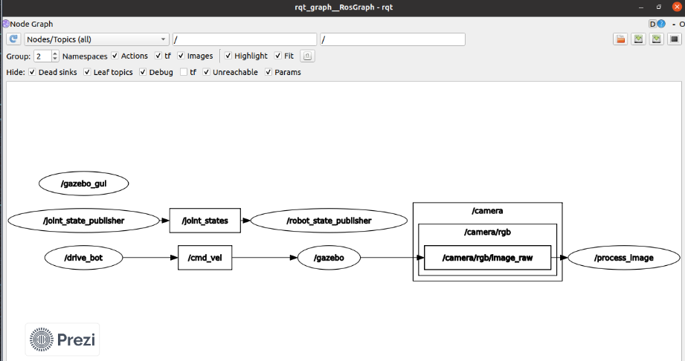
RQT GRAPH

Slide 19
Implementation

Slide 20
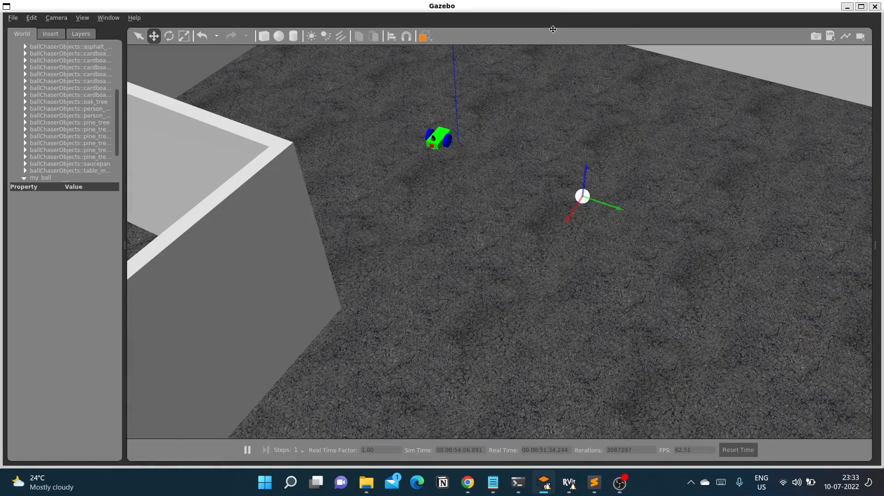

Slide 21
Conclusion
Our proposed system detected the white ball and tracked it .
Accurate velocity results that are both linear and angular along all axes i.e., X,Y,Z.
It successfully chases the white ball created in the gazebo platform.

